Slide 1

#LifeKoKaroLift
PG Diploma in ML/AI

Slide 2



Course : Machine Learning
Lecture On : Gesture Recognition
Instructor : Manish Kumar

Slide 3
Today’s Agenda
1
What is Gesture Recognition Technology?
2
Modelling - Steps
3
Generators
4
3D CNN
5
Conv + RNN

Slide 4
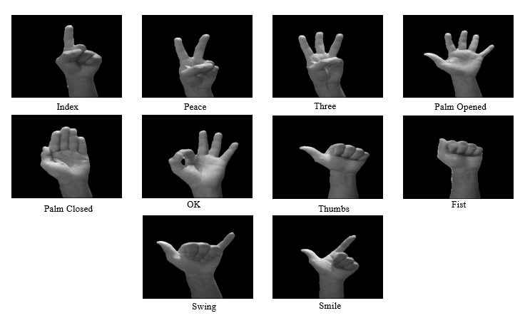
What is Gesture Recognition Technology?
Gesture recognition is the mathematical interpretation of a human motion by a computing device.
Gesture recognition is a type of perceptual computing user interface that allows computers to capture and interpret human gestures as commands. The general definition of gesture recognition is the ability of a computer to understand gestures and execute commands based on those gestures. Most consumers are familiar with the concept through Wii Fit, X-box and PlayStation games such as “Just Dance” and “Kinect Sports.”

Slide 5
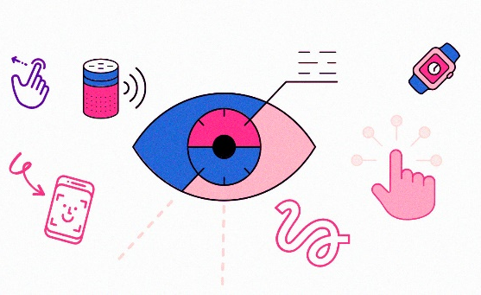
Problem statement
For the application of gesture recognition while watching a movie, the following gestures have been selected with their functionality as described:
Thumbs Up: Increase the volume
Thumbs Down: Lower the volume
Left Swipe: Fast Forward 10 seconds
Right Swipe: Fast Backward 10 seconds
Stop: Pause the movie
The data is in a zip file. The zip file contains a 'train' and a 'val' folder with 2 csv files each for 'train' and 'val' folder. These folders are in turn divided into subfolders which belong to a video/sequence of a particular gesture. These subfolders contain 30 images/frames for the gesture. Note that all the images in a particular video subfolder have the same dimensions but the different videos have different dimensions. These have dimensions either 360x360 or 120x160. Hence, it would require you to do some pre-processing.
Each row of the csv file has the name of the subfolder containing the frames/images of the particular gesture, the name of the gesture and the label assigned to the gesture.
You have to develop a model that trains on the 'train' folder and gives a high accuracy on the 'val' folder. We have withheld the test folder for evaluation purposes. The train and validation folders, in turn, have folders corresponding to the individual videos.

Slide 6
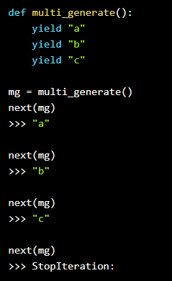
Genrators
generators produce a stream of values, so yielding a single value doesn’t really qualify as a stream.
To do this, we can actually put in multiple yield statements into a generator function. These yield statements form the sequence that the generator will output.
We’ll create a generator and bind it to a variable mg. Then, if we keep passing mg into next(), we’ll get to the next yield. If we keep going past, we’ll be given a StopIteration error to tell us that the generator has no more values to give.

Slide 7
Data Generator - Pseudocode
define img_idx variable with the list of all the image indexes to be used for training & prediction for every gesture input
While True:
Shuffle the training_doc (start of every epoch)
Calculate total number of complete batches that could be created given the batch size
For each complete batch:
Initialize batch_data & batch_labels placeholder’s (will replace the dummy zeros values with processed videos & target data)
For each gesture video in the batch :
For each image in the gesture video:
Pre-process the images to a common shape (using image cropping & resizing)
Normalize the images
Feed the normalized images into batch_data variable
Prepare one hot encoded label vectors per gesture by changing the correct values to 1 in the batch_label variable(target-variable)
Yield the batch_data & batch_label
Check for remaining gesture videos left after creating full batches
Initialize batch_data & batch_labels placeholder’s (with batch_size equals to the number of remaining gesture points)
For each gesture video in the batch :
For each image in the gesture video:
Pre-process the images to a common shape (using image cropping & resizing)
Normalize the images
Feed the normalized images into batch_data variable
Prepare one hot encoded label vectors per gesture by changing the correct values to 1 in the batch_label variable(target-variable)
Yield the batch_data & batch_label

Slide 8
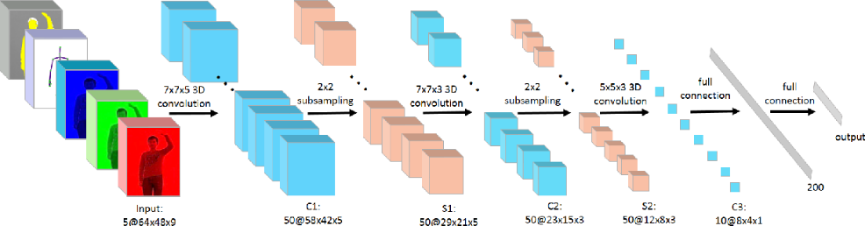
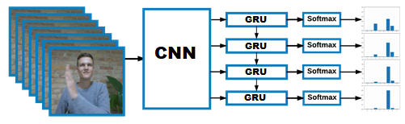
3D Convs and CNN-RNN Stack
For analyzing videos using neural networks, two types of architectures are used commonly
3D convolutional network it’s a natural extension to the 2D convolutions you are already familiar with. Just like in 2D conv, you move the filter in two directions (x and y), in 3D conv, you move the filter in three directions (x, y and z).
the standard CNN + RNN architecture in which you pass the images of a video through a CNN which extracts a feature vector for each image, and then pass the sequence of these feature vectors through an RNN

Slide 9
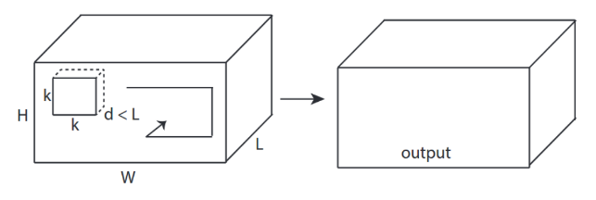

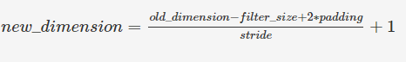
3D convolutional network
In the case of 3D convolutions, the kernel that is used to perform convolutions on the image or the feature map has an additional dimension namely depth.
The kernel performs convolutions by moving in all three dimensions that is x, y, and z-axis. The third dimension is considered to be time as 3D convolutions are used mostly for video classification.

Slide 10
Convolutions + RNN
The conv2D network will extract a feature vector for each image, and a sequence of these feature vectors is then fed to an RNN-based network. The output of the RNN is a regular softmax (for a classification problem such as this one).
Input with spatial structure, like images, cannot be modeled easily with the standard RNN.
Input
CNN
GRU
Dense
Dense
The CNN RNN(GRU) is an RNN architecture specifically designed for sequence prediction problems with spatial inputs, like images or videos.
it is natural to use a CNN as an image “encoder”, by first pre-training it for an image classification task and using the last hidden layer as an input to the RNN decoder which will capture the information hidden in the sequence of the images

Slide 11
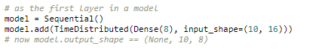
TimeDistributed
This wrapper applies a layer to every temporal slice of an input.
The input should be at least 3D, and the dimension of index one will be considered to be the temporal dimension.
Consider a batch of 32 samples, where each sample is a sequence of 10 vectors of 16 dimensions. The batch input shape of the layer is then (32, 10, 16), and the input_shape, not including the samples dimension, is (10, 16).
You can then use TimeDistributed to apply a Dense layer to each of the 10 timesteps, independently:
The output will then have shape (32, 10, 8).
https://keras.io/layers/wrappers/

Slide 12


Question
Consider a batch of 16 gesture samples, If the size of each image is 128x128 having 3 channels (RGB) and there are total 15 frames present for each gesture video, Input_shape = (15,128,128,3)
We want to apply a pre-trained conv2d model over each frame of the sequence using the time distributed function with 16, (2x2) filters, without padding and stride =2.
16x15x64x64x16
15x64x64x16
16x15x32x32x8
15x32x32x8

Slide 13

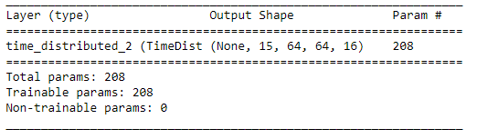

Solution
Consider a batch of 16 gesture samples, If the size of each image is 128x128 having 3 channels (RGB) and there are total 15 frames present for each gesture video, Input_shape = (15,128,128,3)
We want to apply a pre-trained conv2d model over each frame of the sequence using the time distributed function with 16, (2x2) filters, without padding and stride =2.
16x15x64x64x16
15x64x64x16
16x15x32x32x8
15x32x32x8
cnn = Sequential()
cnn.add(Conv2D(16,(2,2),strides=(2,2)))
model = Sequential()
model.add(TimeDistributed(cnn,input_shape=(15,128,128,3)))
model.summary()
Practice in teams of 4 students
Industry expert mentoring to learn better
Get personalised feedback for improvements
08-05-2021

Slide 14
Submission
You need to accomplish the following in the project:
Generator: The generator should be able to take a batch of videos as input without any error. Steps like cropping, resizing and normalization should be performed successfully.
Model: Develop a model that is able to train without any errors which will be judged on the total number of parameters and the accuracy achieved
Write up: This should contain the detailed procedure followed in choosing the final model. The write up should start with the reason for choosing the base model, then highlight the reasons and metrics taken into consideration to modify and experiment to arrive at the final model.

Slide 15
Thank You !

